Slide 1
Thickening domain analysis by image processing
Liu Yixin
2007.9.5 ~ 2007-9.12

Slide 2
Aim
Develop a set of subroutines that deals with the output images of thickening-TDGL model to give statistical information.
Following functions are expected: 1) domain recognition and counting; 2) domain boundary detection; 3) domain features: volume, area, radius and maximum height; 4) domain appearing and vanishing; 5) domain coarsening; 6) domain growth.

Slide 3
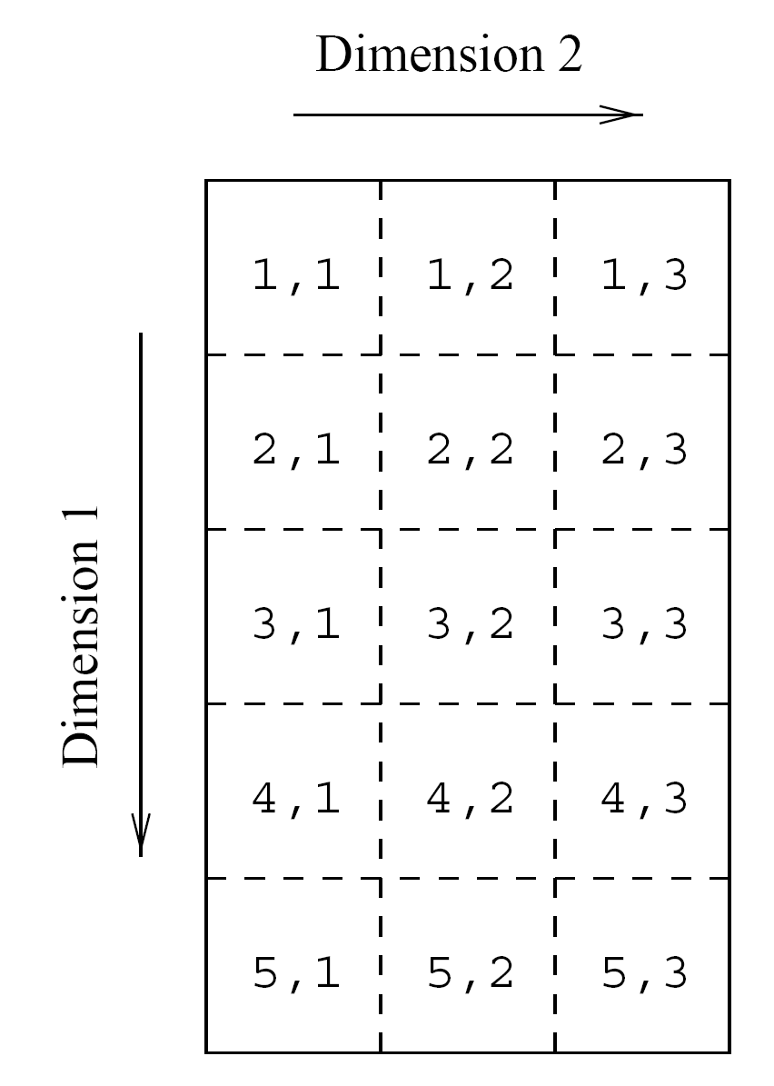
Image format
The image to be processed is an N by N matrix. Each element value ranges from 0 to 255.
0
1
2
3
i
N
0
1
x
2
3
image(j, i)
j
y
N
Note: in FORTRAN, the leftmost subscript stands for row,
i.e. the y direction. It varies fast and called “column major”.

Slide 4
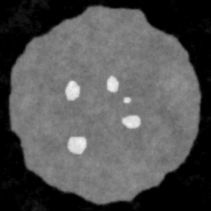
Image for demonstration
Region A:
the almost black area
the void part
Region C:
the thickening dot
the domain we interest.
Region B:
the initial crystal height
the main part
Image size: 256 * 256 pixels^2

Slide 5
Image series
1
2
3
4
5
1
2
3
4
1
3
4
5

Slide 6
Data structure
Defined in the file modTK.f90
DOMAIN_STRUCT
inners(:)
np
nd
x
DOMAIN_POINT
p(:)
y
IMAGE_DOMAINS
DOMAIN_STRUCT
boundaries(:)
pv
labels(:)
maxlabel
gcx
DOMAIN_FEATRUES
features(:)
gcy
C
A
V
R
H

Slide 7
Data representation
Construct a domain list with type IMAGE_DOMAINS: dlist(1:MAX_IMAGE_NUM). Each list element maintains information of all domains within the associated image.
nd is the number of domains.
labels(:) stores the labels assigned to domains.
maxlabel is the max label has been assigned, that is the number of different domains in the image series.
inner(:), boundaries(:) and features(:) are the inner points, boundary points and features of each domain in the current image, respectively.

Slide 8
Constants
n1, n2: the y and x direction image size.
MAX_IMAGE_NUM: the max number of input image that can be accepted.
MAX_DOMAIN_NUM: the max number of domains within an image.
MIN_DOMAIN_POINTS: the min number of points that a domain should contain.
DOMAIN_LABEL_SPACE: this constant is used to defined the space between domain and label text when drawing the domain label in the image.

Slide 9
Domain recognition
Histogram
Threshold to binary mode
Domain labeling
Domain extraction

Slide 10
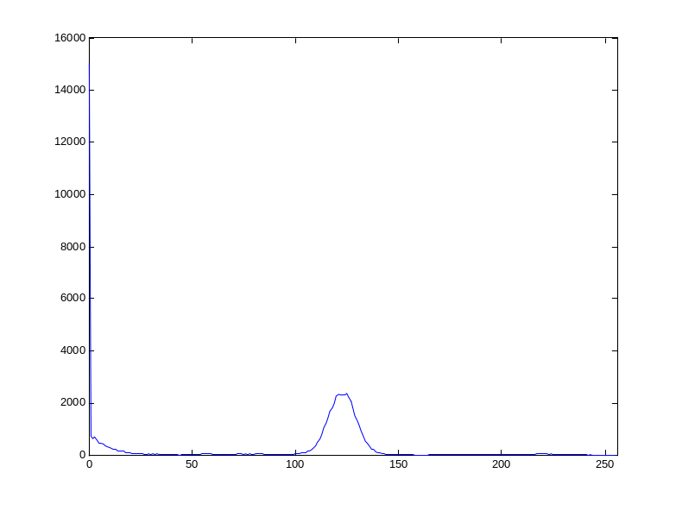
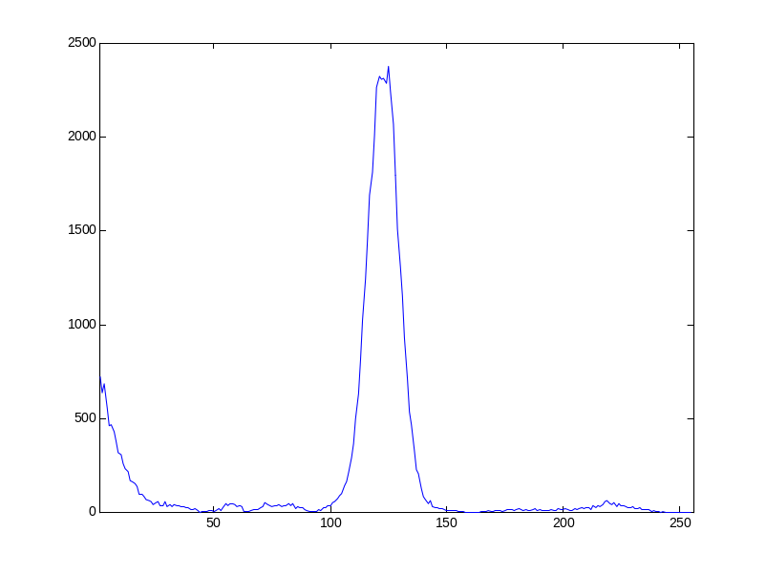
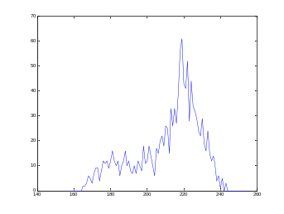
Histogram
The result is stored in the vector array is {integer hist(1:256)}
Visualization: moveto_w() and lineto_w().
Region B
Region A
Region C
With hist(0)
Without hist(0)

Slide 11



Threshold
Working in two mode.
Mode=1: let the value be 255 if the origin value > thresh
Mode=2: invert
Thresh=10
Thresh=83
Thresh=160

Slide 12

Domain labeling
Algorithm: Scan the binary mode image, find the first pixel whose gray value is 255. Then search its 8 neighboring pixels, set the pixel value to “label” if its previous value is 255, repeat above operations until all connecting pixels are identified. Scan the image for another domain until all domains are labeled.
i-1
i
i+1
(i-1, j-1)
(i, j-1)
(i+1, j-1)
(i-1, j)
(i+1, j)
(i-1, j+1)
(i, j+1)
(i+1, j+1)
j-1
j
j+1
井上诚喜等著，白玉林译，实用数字图像处理，科学出版社，2003

Slide 13
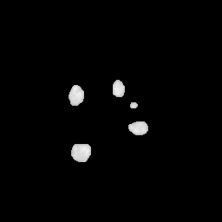
Domain extraction
In this procedure, we must get all points’ position and its value of each domain and store them into the inners(:) list in dlist(i), where i stands for the ith image.
getdomain_inners(), the subroutine, must exclude boundary domains whose part of boundary is on the image bound and noise which has less than MIN_DOMAIN_POINTS points.

Slide 14

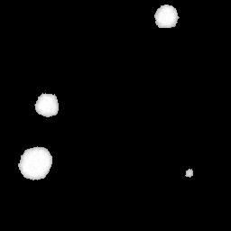
Excluded boundary domains
We are not interested with domains which on the image border, we will ignore it when perform extraction. This is done by the subroutine getdomain_inners().
Threshold image
extraction image

Slide 15
Domain boundary detection
Algorithm
Boundary extraction

Slide 16
Algorithm
starting position
6
5
4
i-1
i
i+1
6
7,5
4
3
j-1
6
5
4
7
0
1,3
2
j
7
X
3
0
1
2
j+1
0=>4=>5
0
1
2
4
Previous boundary point
0
Current boundary point
7,5
Next search point

Slide 17
Algorithm
We have these relation: current direction respects to previous direction =>previous boundary point direction respects to current point => next search direction
5=>1=>2; 6=>2=>3; 7=>3=>4; 0=>4=>5; 1=>5=>6; 2=>6=>7; 3=>7=>0; 4=>0=>1

Slide 18
When domain boundary touches image border
i=1
i=2
6
5
4
6
5
4
j=1
7
3
7
3
Pixel to be
searched
j=2
0
1
2
0
1
2
Boundary pixel
6
5
4
6
5
4
j=n1-1
7
3
7
3
Out off image
j=n1
0
1
2
0
1
2
Next search pixel
i=n2-1
i=n2

Slide 19
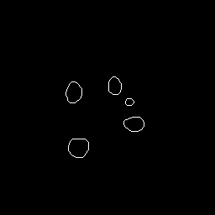
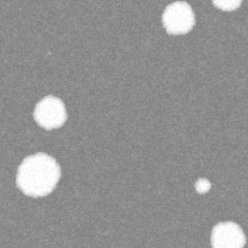
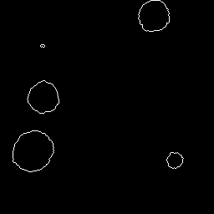
Results
Normal condition
Domain
whose boundary
encounters
image border

Slide 20
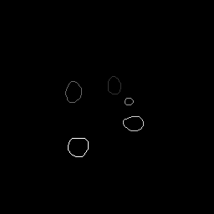
Boundary extraction
In this procedure, we must get all points’ position and its value of each domain boundary and store them into the boundaries(:) list in dlist(i), where i stands for the ith image.
The subroutine is getdomain_boundariess().

Slide 21
Domain features
Circumference or perimeter
Area
Volume
Maximum height
Gravity center
Radius

Slide 22

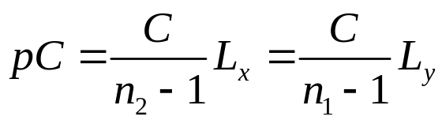
Circumference
The circumference of the domain is calculated in the subroutine traceboundary().
The length of two diagonal boundary pixels are square root of 2, while the length of two adjoined boundary pixels are 1.
Conversion to physical quantity,
1

Slide 23
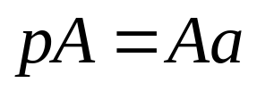
Area
The area of a domain is simply the total number of domain interior pixels.
However, we can convert this area to physical quantity by multiplying the actual area of a single pixel. That is,

Slide 24
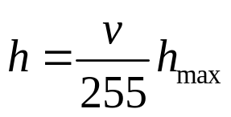
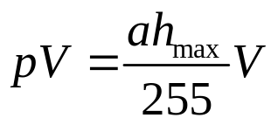
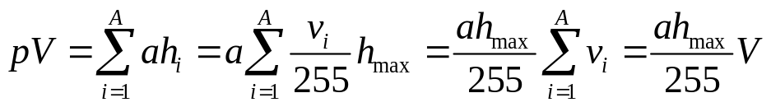
Volume
Similarly, the volume is a sum of gray value of all pixels over the whole domain.
Since the gray value is range 0 to 255, the conversion equation is,
The physical volume related to this volume as,

Slide 25
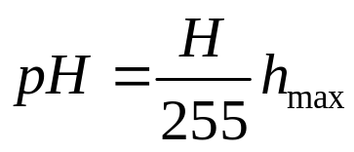
Maximum height
The maximum height is the largest gray value of pixel within the domain.
Convert this height to physical quantity by,

Slide 26
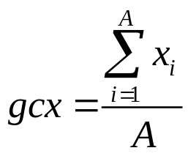
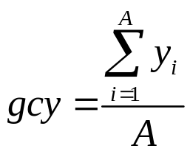
Gravity center
The gravity center is
Note that, here we do not consider the gray value of each pixel, means that the gravity center we defined here is merely correlated to the shape of the domain but not a true center of mass.

Slide 27
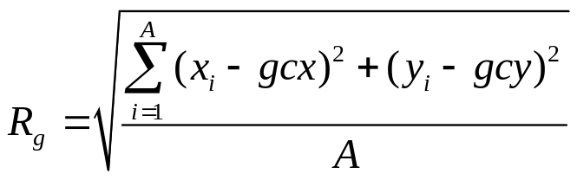

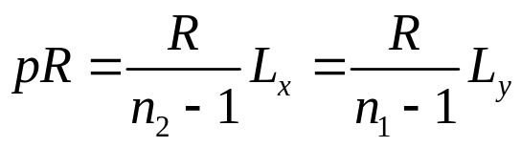
Radius
We calculate the radius by the means of radius gyration. The radius gyration of a domain is,
For a circle, the relation between radius and radius of gyration is,
Related to physical quantity by,

Slide 28
Kinetic process
Domain identification
Data analysis and output

Slide 29
Domain identification
Assume that domains grow or diminish steadily and they do not move in the matrix. Then we can consider two domains in two neighboring images a same domain if the gravity center of the small domain is in the big one’s interior.
We must assign a unique ID number, here we named it “label”, to each domain. If a domain has the same label as other domains in other images, then they are the same domain. In the program, we use the labels(:) to store these labels for each domain.
We also need a maxlabel which will maintain the maximum label we have assigned till current image, since we assign a newly formed domain a label that increases by 1.

Slide 30


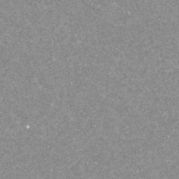
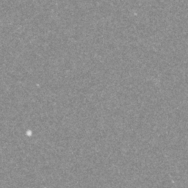
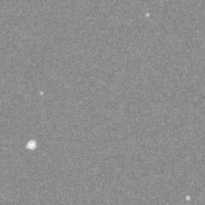
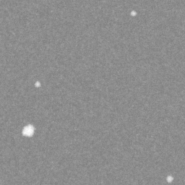
Demonstration

Slide 31
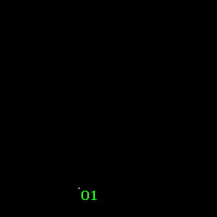
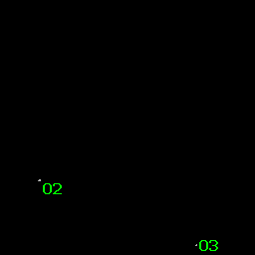
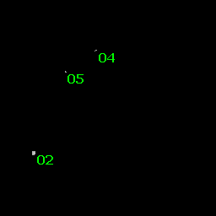
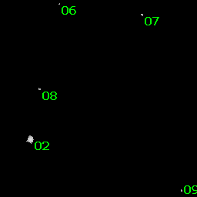
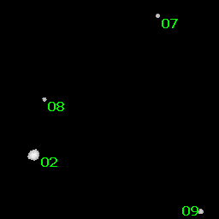
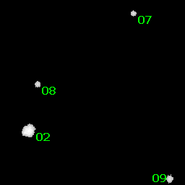
Demonstration

Slide 32
Data analysis
Domain number variation with time: simply use dlist(:)%nd to construct a list.
Domain features evolution with time: for each image, we must find the label of domain first, then add its features to each features list of that label accordingly.

Slide 33
File format
Image | C | A | V | R | H | gcx | gcy
1 | 2 | 3 | 4 | 5 | 6 | 7 | 8

Slide 34
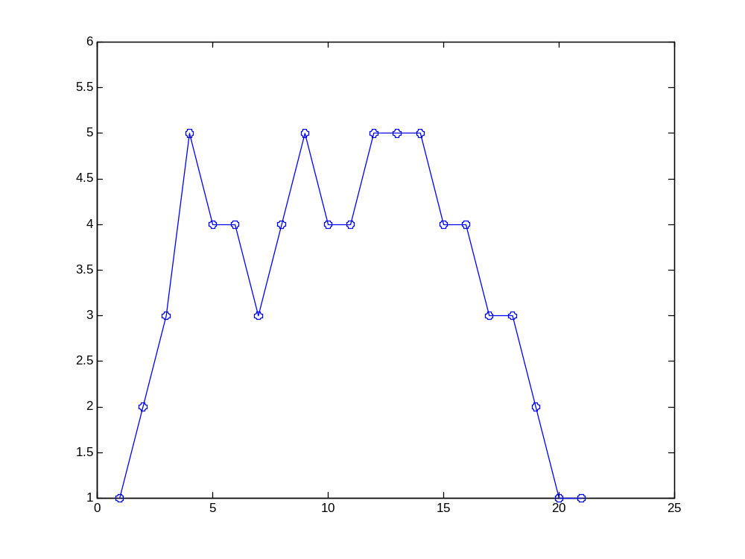
Domain number
Domain number
Reduced time

Slide 35
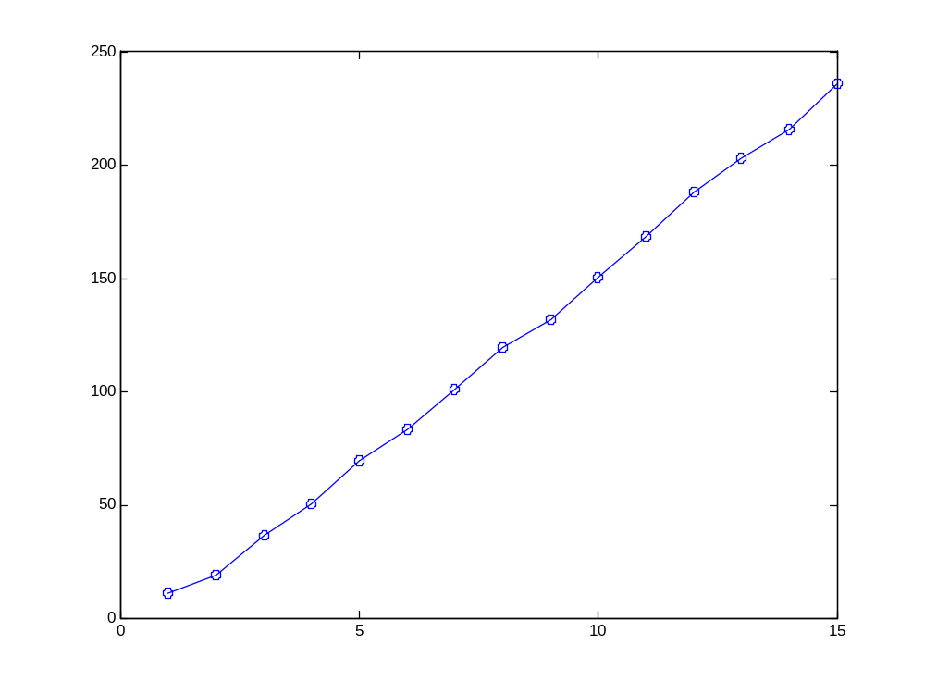
Circumference
Domain: label 02
Circumference
Reduced time

Slide 36
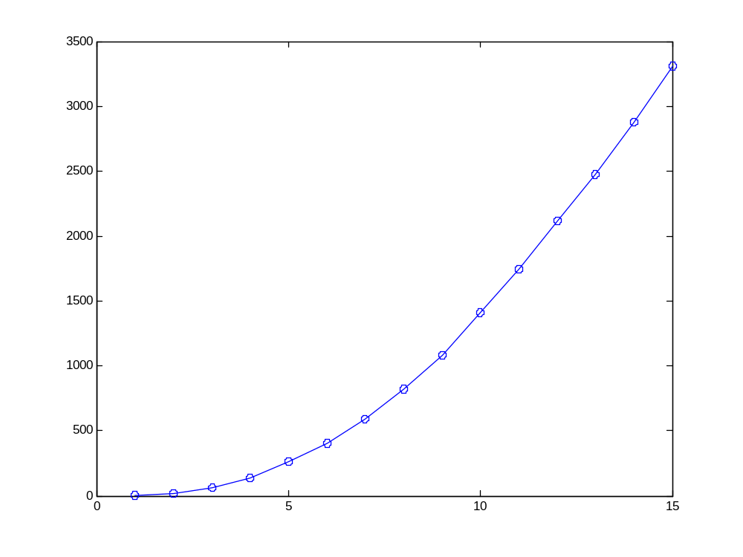
Area
Domain: label 02
Area
Reduced time

Slide 37
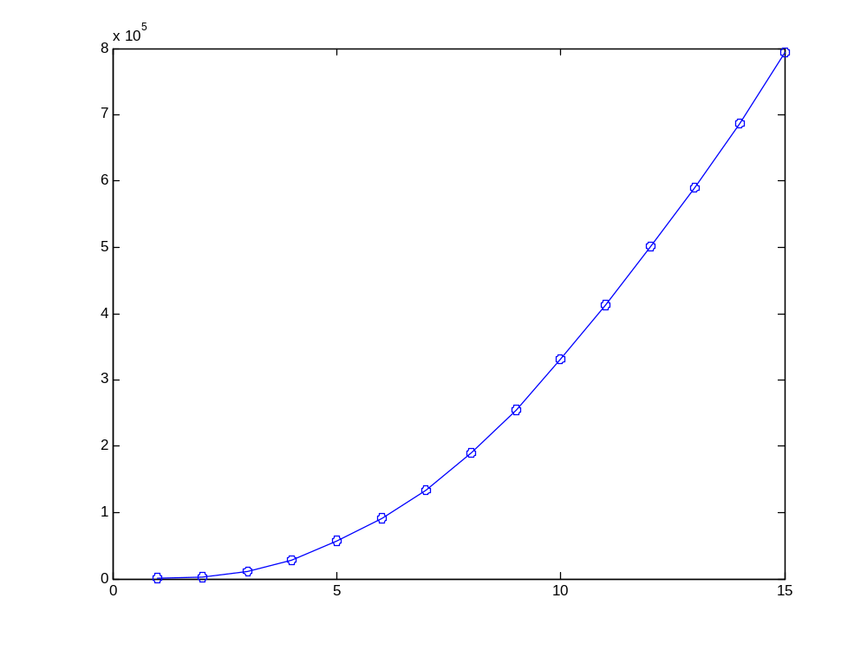
Volume
Domain: label 02
Volume
Reduced time

Slide 38
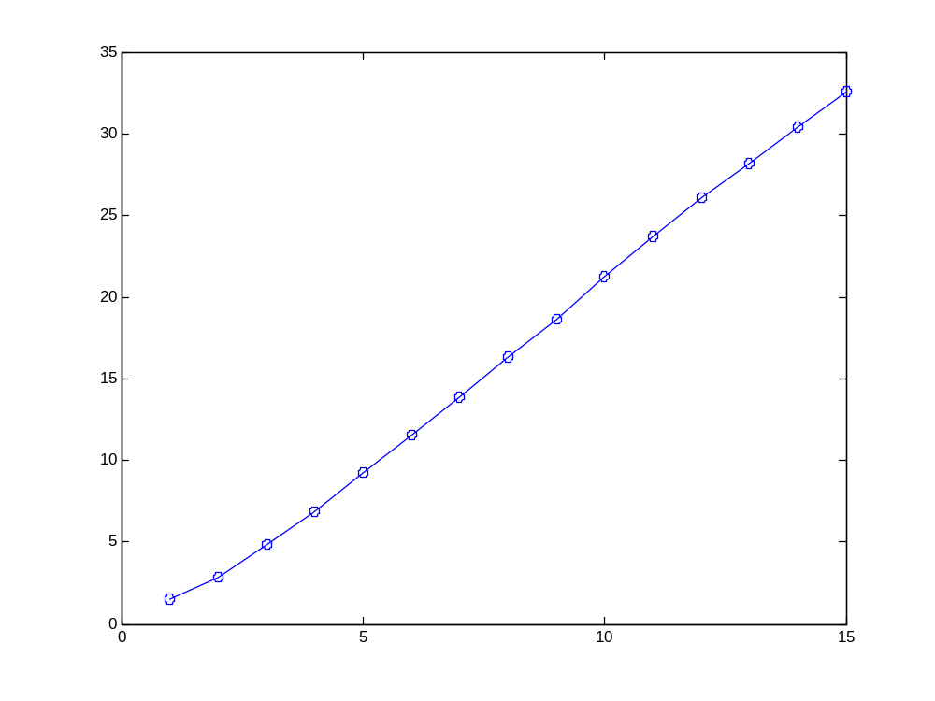
Radius
Domain: label 02
Radius
Reduced time

Slide 39
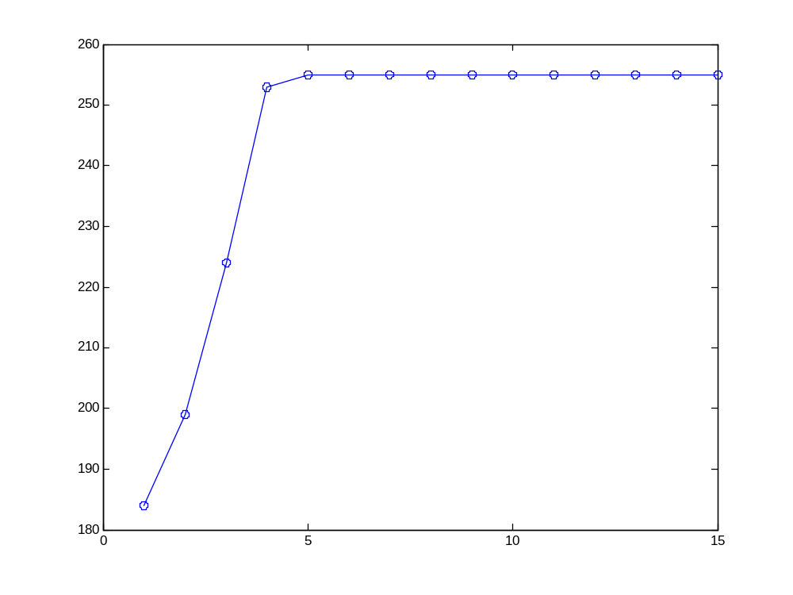
Maximum height
Domain: label 02
Maximum height
Reduced time

